Slide 1


NEUTROSOPHIC COGNITIVE MAPS FOR PRESCRIPTIVE MODELLING
Presented By : J.Derrick (22MCB0013)
Guided By: Prof. Vasantha W B

Slide 2
Contents
Introduction
Problem Statement
Objective
Research Gap
Proposed Work
Methodolgy
Proposed Working
Output
Future Work
Conclusion
References

Slide 3
Introduction
Business analytics includes the field of prescriptive modelling, which suggests actions for a system to take in order to achieve a goal.
One of the topics that has generated the most interest in recent years is this one since it offers crucial assistance to decision-makers.
Prescriptive analytic models are designed to pull together data and operations to produce the roadmap that tells you what to do and how to do it right the first time.

Slide 4
Neutrosophic Cognitive Map (NCM)
Neutrosophic Cognitive Map (NCM) is a graphical modelling tool used in decision-making and problem-solving processes.
It incorporates the notion of neutrosophy, which deals with uncertainty and indeterminacy more flexibly.
It can be used to assess students' academic performance, including their grades and marks, as well as other aspects, including inter-student interactions, demographic, socioeconomic, and psychological variables.
Neutosophic sets, which can be any real number between 0 and 1, are used by NCM maps to express the degree of truth (T), degree of indeterminacy (I), and degree of falsehood (F) of relationships between concepts or variables.

Slide 5
Problem Statement
Neutrosophic Cognitive Maps (NCMs) are the perfect tool for supporting student academic performance decision-making because they provide a strong foundation for modelling and reasoning in the face of uncertainty, ambiguity, and degree of truth.
The current issue is the lack of a modelling framework that synchronizes the descriptive strength of NCMs with the capacity to produce meaningful recommendations for decision-makers in dynamic and uncertain contexts.
To close this gap, we propose developing PRV-NCM, which combines prescriptive modelling and non-conformal computation.

Slide 6
OBJECTIVE
The main goal of this study is to create and assess prescriptive learning strategies that make use of Neutrosophic Cognitive Maps (NCMs) to improve decision-making in student academic performance.
This study addresses the following precise goals:
To create and put into use a prescriptive model capable of accommodating Neutrosophic Cognitive Maps (NCM) that can handle a degree of false, degree of ambiguity/indeterminacy, and degree of truth in a flexible manner.
The main objective is to get the results based on the performance aspect of students using likert scaling .
To recognize pupils who might be in danger of performing poorly or failing early in their academic careers. Early detection enables prompt support and interventions, which may enhance student results.

Slide 7
Research Gap
While Fuzzy Cognitive Maps have been used as a prescriptive model, the PRFCM model cannot handle indeterminacy.
In many studies that comprises of human decision-making and thinking process, Indeterminacy is largely involved.
In all studies, they are a lot of uncertainty, to include it, we are adopting the NCM (Neutrosophic Cognitive Maps) with a prescriptive model that would provide us with the degree of truth (T), Falsehood(F), Indeterminacy (I) or Uncertainty in a more flexible way.
NCMs function as a graphical modelling tool used in decision-making and problem-solving processes for decision support and analysis.

Slide 8
Proposed Work
In this research, we propose creating prescriptive models termed Prescriptive NCM (PRV-NCM) based on Neutrosophic Cognitive Maps (NCMs) and metaheuristic algorithmic approaches.
NCM is a mathematical and graphical modelling tool utilized in the process of making decisions and resolving issues that have indeterminacy.
The main distinction between neutrosophic cognitive maps and Fuzzy Cognitive Maps is that they integrate the idea of Neutrosophy, which approaches uncertainty and indeterminacy precisely.
It represents the degree of truth (T), indeterminacy (I), and falsehood (F) of relationships between ideas or variables.
The prescriptive modelling here refers to a particular kind of map or visual representation that offers advice, suggestions, and directions for particular activities or decisions. These maps are designed to help users make informed choices or take particular steps based on the information presented.

Slide 9
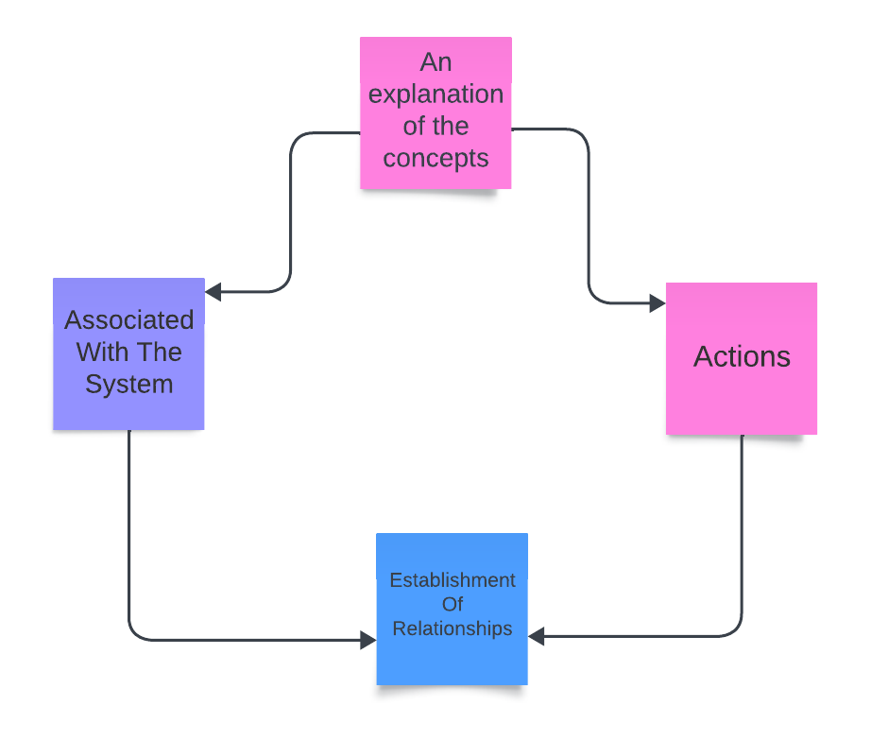
METHODLOGY
Human Intervention (Characterization Of NCM)

Slide 10
Concepts of the NCM
The system layer associated with the system and the action layer are the two key categories used to categorise the NCM's concepts in the first stage.
The system-related notions that define it are found in the first layer.
Prescriptive or action concepts must be found in the action layer for the system to reach the intended state.

Slide 11
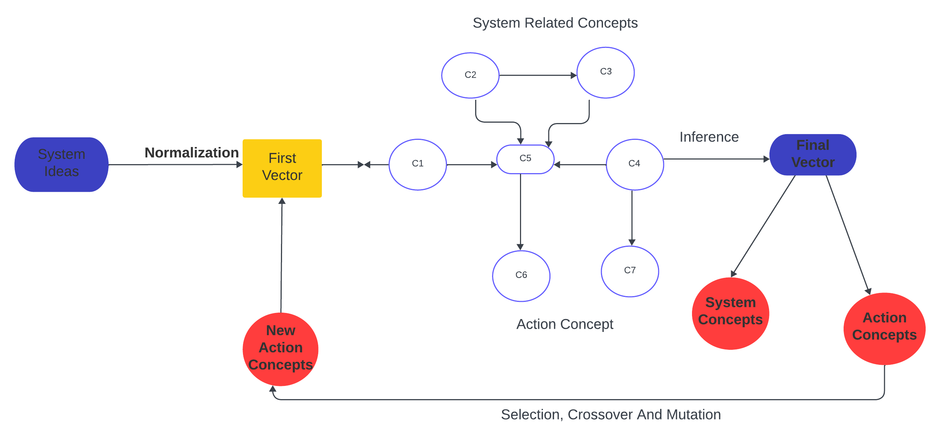
Computer Intervention (Initial Instantiation, Inference and optimization)

Slide 12

System Related Concepts
Concepts that are part of the system under study are called system-related concepts.
System concepts are the characteristics of a system that interact with one another to accomplish a goal.
For instance, an academic educational system is one in which the performance aspects include the student's grades and marks, which are reflected in the system's concepts.

Slide 13

Action Concepts
Action concepts are those that influence the system's changeable concepts in order to improve them and bring about the desired outcome. Some changeable ideas connected to the system are causally impacted by these notions. Furthermore, it is these variables that make up the prescriptive model.
So the first step is initializing variables, objects, or programme components by establishing their initial values or states to the system concepts .
Then from the system concepts it transfers to the initial vector initial vector that is used to represent the starting position or state of a vector before any operations or transformations are applied to it.

Slide 14
Proposed Working
Then it passes through the action map and the system-related concepts where inference is been made up depending on the process of drawing conclusions or making predictions based on evidence, reasoning, or existing knowledge. It involves using available information to reach a logical or probabilistic judgment about a specific situation or question.
Then, it reaches the final vector that represents the ending position of a system after some operations, transformations, or motions occurred. The final vector is usually derived from an initial vector, representing the starting position or state, by applying various operations or changes.

Slide 15
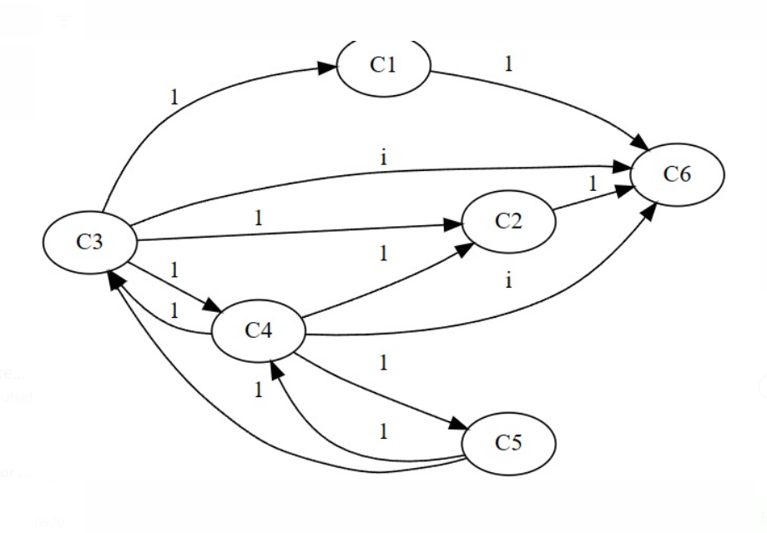
Output

Slide 16
Output
C1= Student
C2 = Performance
C3 = Laptop
C4 = Pressure
C5 = Nervous
C6 = Marks

Slide 17
Future Work
The future enhancement could be Enhancing simulations with AI planning algorithms.
Expanding platform integration with campus ecosystems; fortifying privacy controls and audit mechanisms; conducting longer trials across socioeconomic segments.
Adding image and audio analytics for sentiment analysis; incorporating teacher inputs to refine model accuracy.

Slide 18
Conclusion
The primary objective is to develop and evaluate prescriptive learning techniques that employ neurosophic cognitive maps (NCMs) to enhance students' academic performance by improving their decision-making.
The use of NCMs in the construction of an adaptive prescriptive modelling system to improve student academic attainment was examined.
The methodology tackles significant obstacles in simulating intricate interrelationships among qualitative elements influencing educational results and offering practical solutions.
The exact objectives were to develop and implement a prescriptive model that could support Neutrosophic Cognitive Maps (NCM) and handle degrees of falsehood, ambiguity/indeterminacy, and truth in a flexible way.

Slide 19
References
1.P. S. Aithal and S. Aithal, “Implementation Strategies of Higher Education Part of National Education Policy 2020 of India towards Achieving its Objectives,” 2020. [Online]. Available: https://ssrn.com/abstract=3741425.
2. Elliott, T. L., & Pfotenhauer, K. M. (2022). Classification and diagnosis of diabetes. In Primary care - Clinics in office practice. Vol. 49. No. 2 (pp. 191–200). Elsevier, http://dx.doi.org/10.1016/j.pop.2021.11.011.
3. L. J. Graham, S. L. White, K. Cologon, and R. C. Pianta, “Do teachers' years of experience make a difference in the quality of teaching?,” Teaching and Teacher Education, vol. 96, article 103190, 2020.
4. Olisah, C. C., Smith, L., & Smith, M. (2022). Diabetes mellitus prediction and diagnosis from a data preprocessing and machine learning perspective. Computer Methods and Programs in Biomedicine, 220, Article 106773. http://dx.doi.org/10.1016/j.cmpb. 2022.106773.

Slide 20
THANK YOU

